Slide 2
Hosting Drupal 8 on AWS
Notes:
Title Page

Slide 3
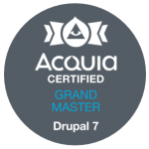

Who are we?
Jonathan “Jack” Franks
Software developer since 1990 or so.
Drupal developer since 2013.
I work for Breakthrough Technologies.
Love the Drupal community (that’s you!).
Back-end developer.
I’ll do CSS if I *have* to.
Maintain and contribute to some modules.
Oh, and BTW, Acquia Certified Grand Master!
And my favorite Muppet is Pepé the King Prawn.
Former motorcycle rider.

Slide 4
Who are we?
Michael Wagner
DevOps Engineer and practitioner
25+ years of *nix admin experience
6+ years AWS experience
Current motorcycle rider
Home Automation (level: overkill)

Slide 5
What we’ll cover
Hosting Drupal solutions on AWS
Environment setup
Development workflow
Deployment
Additional components

Slide 6
What we won’t cover
This is more of a how-to than a why-should-I. This is how we do it and why we do it, not convincing you why you should do it.
The platform hosts are great for most sites, but we had specific needs.
In-depth comparison of AWS hosting vs platform hosting.

Slide 7
Why Self Hosting?

Slide 8
Why AWS over cloud hosting?
We do lose some of the niceties like push-button deployments, but we needed more flexibility than the big Drupal cloud hosts could give us.
Integration with non-Drupal apps like Tao.
Consistency of underlying servers, backups, etc. across all applications.
3rd party config and infra management tools like Chef and Terraform.
Customizing the environment for tools and extensions that aren’t always available.
The ability to use our preferred versions of additional services like Solr.
Use our own git repos with pull requests.
Fine tune scalability during heavy use periods.
Cost control.
Storage and backups.
Log aggregation and alarms.
Firewall and network security.

Slide 9
Cost control
Control cost by sizing server capacity and components on a schedule or on load change.
Use of EC2 and RDS reserved instances aggregated across projects to drive costs down
Centralized billing of multiple project accounts

Slide 10
Storage and backups
Daily full and point-in-time backups for DB servers.
Daily, weekly, monthly snapshots of key application server disks.
Custom backup solutions for some of our software.
EFS or S3 for shared Drupal storage (public:// and private://).

Slide 11
Log aggregation and alarms
Custom metrics and alarms for infrastructure and application logs.
CloudWatch Logs for aggregation and CloudWatch Insights for analysis and reporting.
Record Watchdog log in CloudWatch.
Alarm email distributions per project for different types of alarms.
Things we check:
CPU utilization
Errors (5xx count, etc.)
Disk and RAM utilization
EC2 and RDS status and events
Web request rates
Etc.

Slide 12
Network Security
Fine-tune both inbound and outbound access with Security Groups and WAF.
Configured differently per environment. Lower environments restricted to BT and customer networks.
No servers are in public subnets. They're only accessible via requests through load balancers.
Secure channels for external API calls.
Internal load balancers keep cross-application comms on high-speed, private internal network.

Slide 13
Configuration management
Configuration as code.
Chef server manages ENV specific installs and config on all app servers
All projects start basically the same.
Clone Base, Apache, Drupal, etc., cookbooks from our repository.
Customize per project.
Devs can directly create cookbook PRs which Ops then reviews and applies.
Manage custom Drupal CMI files for environment-specific settings.
Provides drift control.

Slide 14
What do we need for a Drupal 8 site?

Slide 15
What we’ll need
New EC2 server based on an Amazon Linux AMI.
Shared file system.
RDS.
AWS Certificate Manager.
Additional services.

Slide 16
What is a soloist?
Definition
Animation for soloist and blue/green deployment.
Get rid of secrets management? Mention that these are for human access like Drupal admin. But could go to parameter store and have Chef pull in the secrets automatically.

Slide 17
EC2
EC2 houses the web server.
For a Drupal 8 application, typically 2 moderately-sized servers as a base, adjusted for load.
High Availability
Minimum of 2 servers behind an ALB in geographically different AZs.
ALB Host-based-routing directs requests to appropriate application servers based on request values (e.g., hostname)

Slide 18
LAMP
Install LAMP components, choosing specific components and versions.
PHP-FPM, PHP extensions, middleware.
Custom PHP settings in php.ini and php-fpm.ini.
Change timeouts.
Add extensions.

Slide 19
Shared File system
EFS or S3.
EFS is much easier to use and configure.
EFS mounts like part of the file system. Drupal doesn't know that it's anything other than a disk.
S3 can be particularly problematic with Drupal 8.
Used for public/private files and php tmp.

Slide 20
rds
Database server.
High Availability
Minimum of 2 nodes in Multi-AZ/failover configuration
Nightly backups.
Point-in-time recovery availability.
Pick the database engine and version.
MySQL
MariaDB
Aurora
And we don't need a DBA to do this!

Slide 21
Aws certificate manager
Provides free SSL certificates.
Auto approval and renewals based on DNS authorizations.
Allows us to run QA and Staging with SSL more readily so that our environments are the same.
No self-signed certificates. Environments are set up the same.

Slide 22
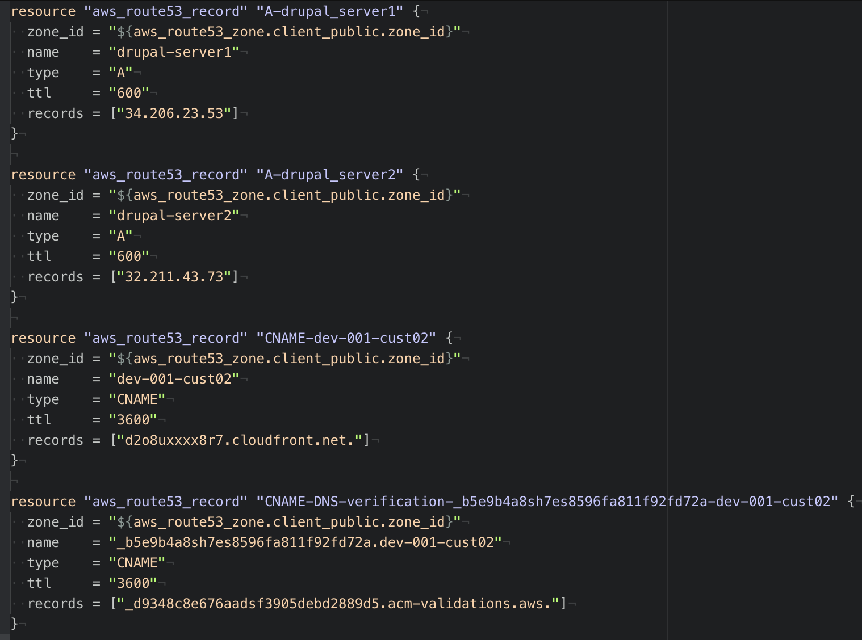
DNS management
Previously, we used external registry services like GoDaddy and Network Solutions.
Consolidated all project DNS to AWS.
Route 53 is AWS's DNS registry provider. And it does the DNS.
Programmatically managed by Terraform. No slogging through clunky, 3rd party web UI.
Provides history and documentation and a standard process for configuring new servers.

Slide 23
Additional Services
Elasticache Redis.
Varnish.
Apache Solr on EC2.
SES (Simple Email Service, SMTP) for outbound email.
CloudWatch for log aggregation, monitoring, and alarms.
SNS (Simple Notification Service) for alarm delivery.
GuardDuty watches for suspicious network and AWS API activity.

Slide 24
Environment setup

Slide 25
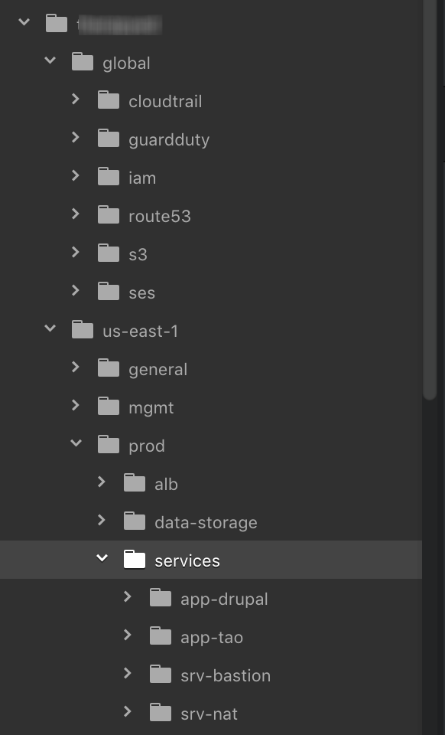
INFRASTRUCTURE
Infrastructure as code. Terraform.
We use Terraform to set up most of the AWS services from the ground up - VPC, Subnets, Security Groups, LBs, EC2, RDS, etc.
Commit and track each change of infrastructure configuration.
Keeps things consistent across projects.
Reduces human error.
Notes:
We start with an empty AWS account (each customer app gets its own account). We customize our Terraform code and make it go, then the environment is ready within an hour or so. This used to take days of setting up stuff, remembering you're missing a dependency, re-setting it up, and so on.

Slide 26
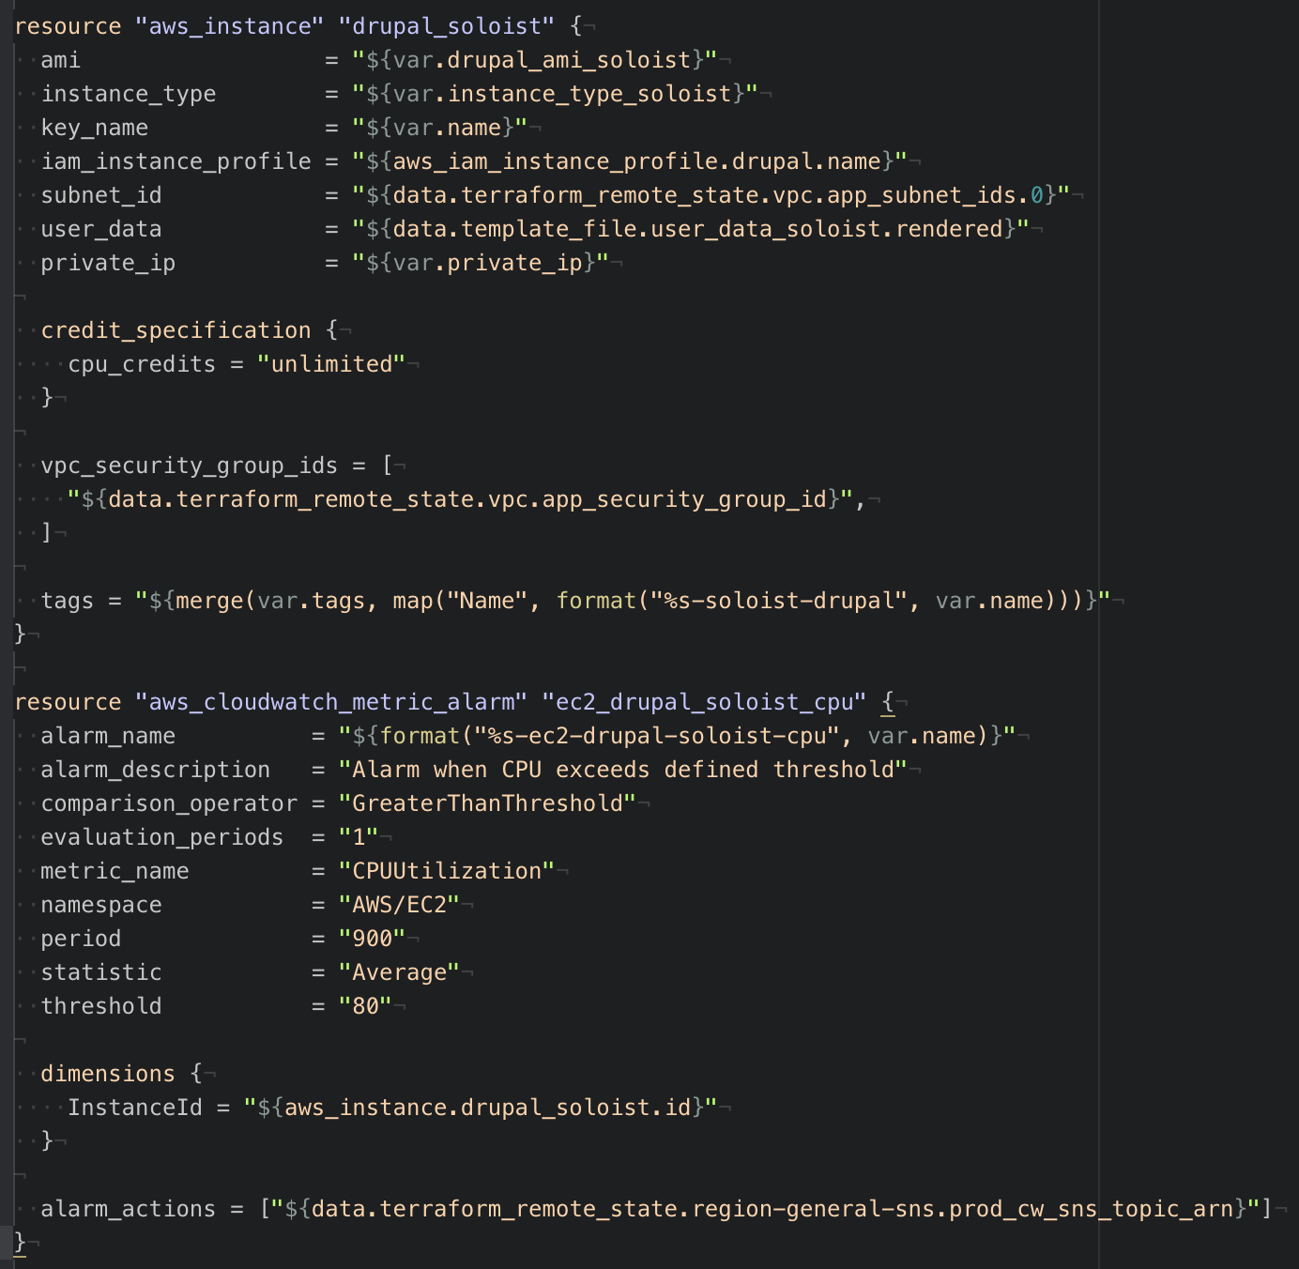
Terraform example
Terraform code to spin up Drupal soloist EC2 and create a CPU utilization metric alarm.
Parameter driven.
Custom TF modules allow code reuse for common tasks between projects.
Notes:
We have a set of TF modules that include config for additional services, like common config for every project, config for S3 that only some projects need, etc. We have a growing library of reusable TF modules.

Slide 27
EC2 setup
Setting up Apache and PHP/PHP-FPM:
Chef cookbook installs Apache, PHP and components, and configures them.
Each project has its own cookbooks, based on our core templates.
Secrets management with 1Password.
Vaults for each project.
Ops creates credentials for each project and environment.
Team can access them through project specific 1P vaults.
Notes:
That keeps all of our secrets out of non-secure channels. No post-it notes, slack, email, text messages, etc. It's all secure.

Slide 28
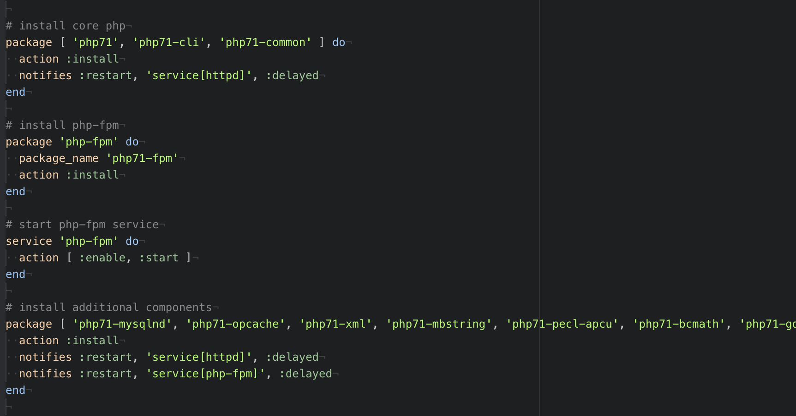
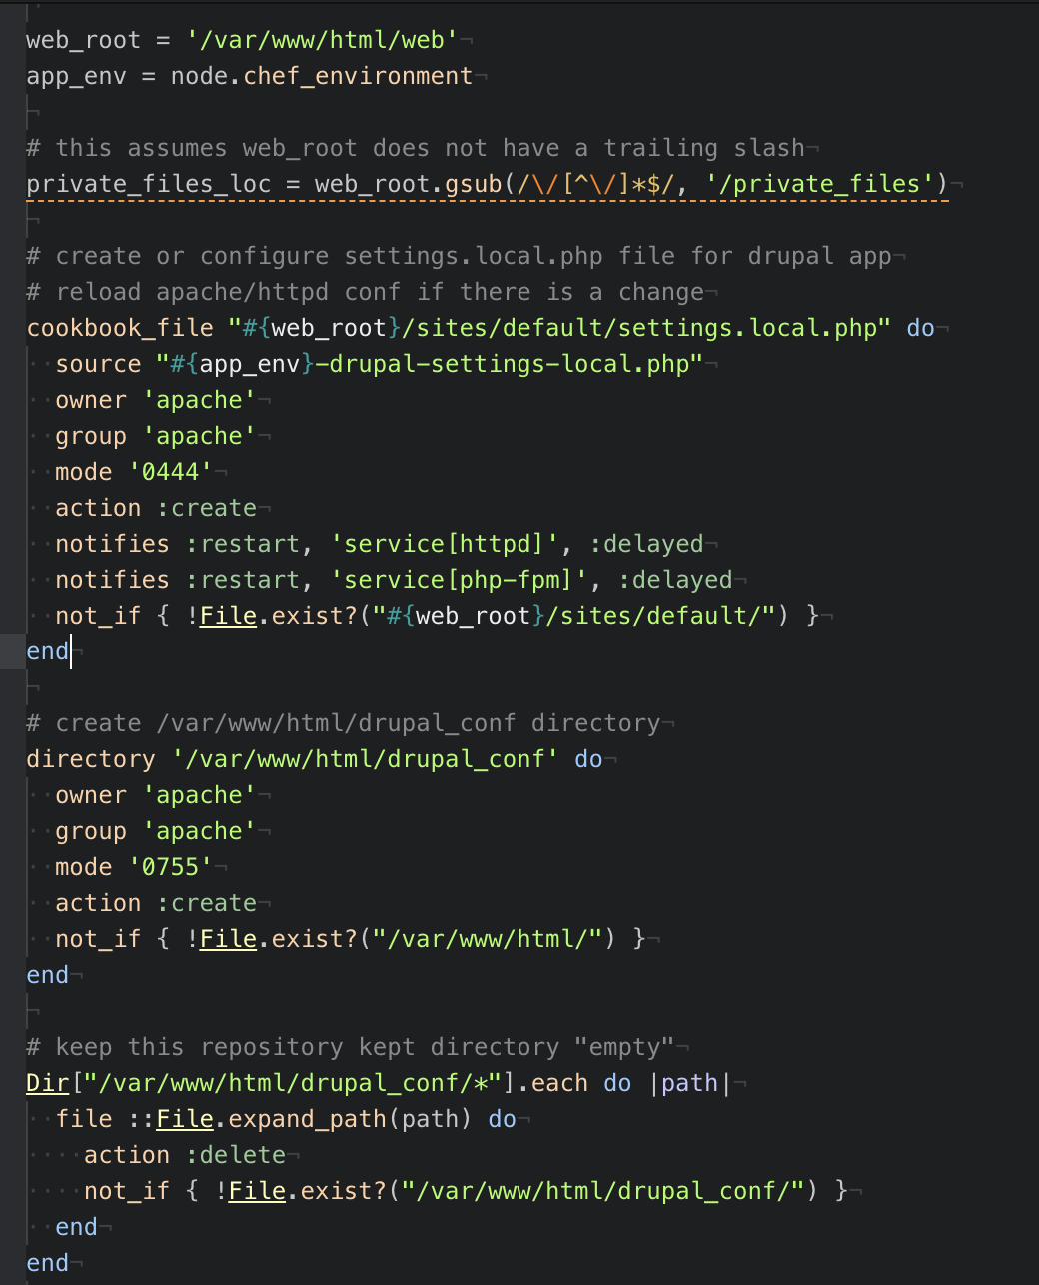
CHef example
Above: Chef cookbook code to install PHP
Right: code to configure PHP

Slide 29
Server and drupal updates
OS/middleware updates done manually or with AWS Systems Manager.
Drupal update manager module sends notifications for security updates. composer.lock in git, deployment and composer install to update.
Notes:
AWS SM checks each server for compliance.

Slide 30
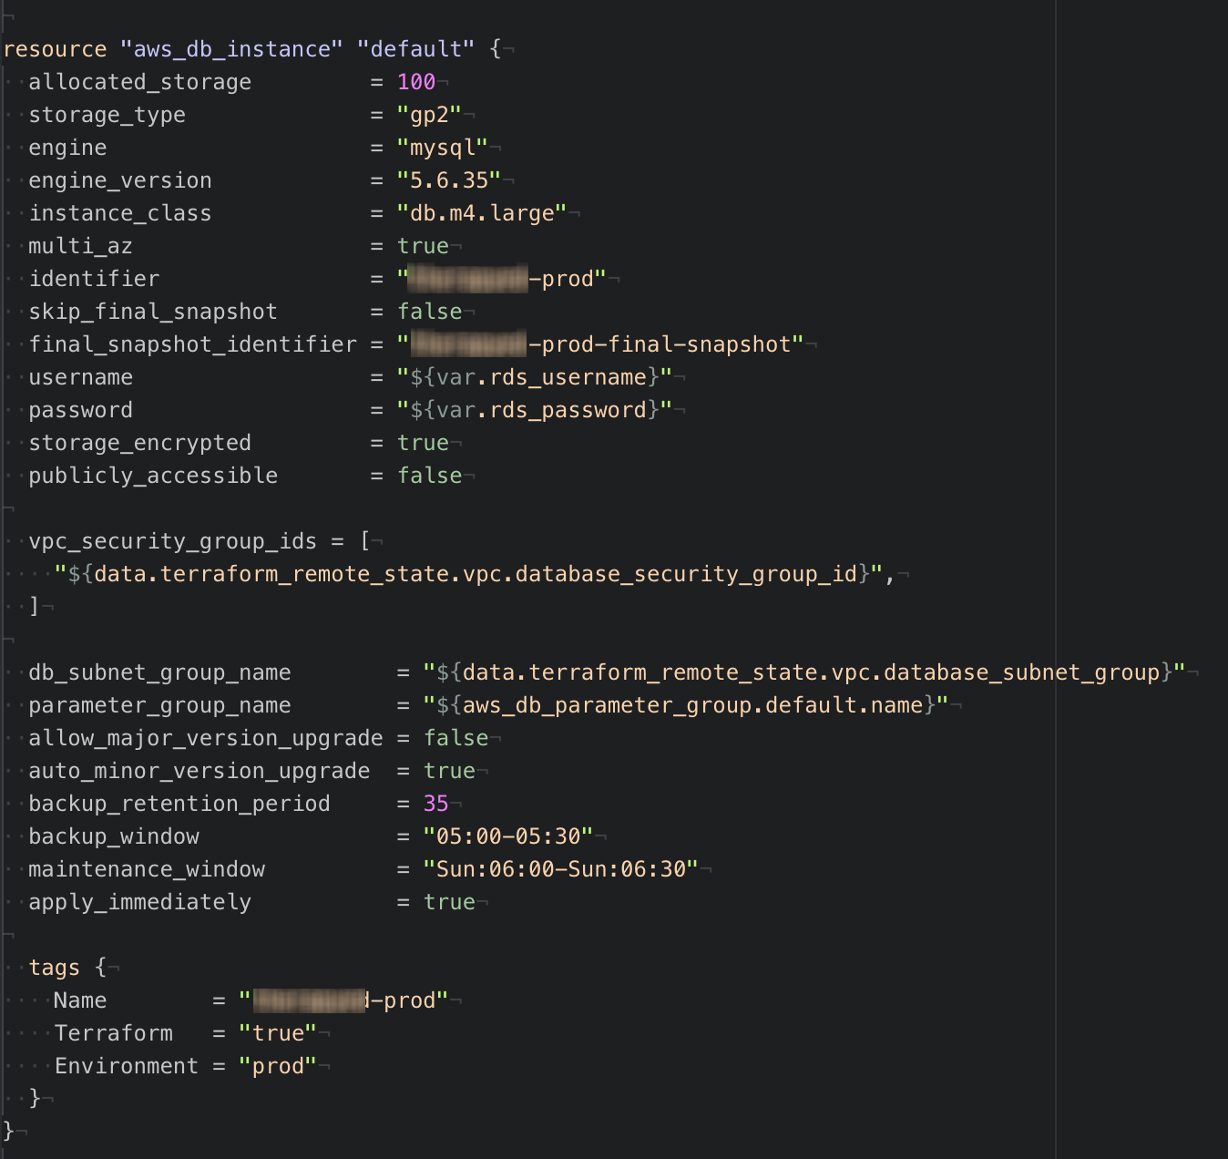
Rds setup
We use Terraform to spin up the initial RDS instance and configure it.
Create users and network permissions manually with sql scripts via MySQL client.
Store secrets in project’s 1Password vault.

Slide 31
Efs/s3 setup
Terraform sets up EFS and all related AWS components.
Set up mount details in the soloist’s /etc/fstab.
Pushed to ASG hosts during initial deployment.

Slide 32
DRUPAL Cron
Drupal configured to use external cron web request with token.
AWS Lambda function periodically makes drupal cron request.
Lambda/Drupal communications kept within private network.

Slide 33
Development workflow

Slide 34
Development workflow
Local dev environments using Docker/Lando.
Remote code repo in Git.
Tagged releases.
Feature branches from master.
Hotfix branches from tags.
Pull requests approved by tech lead.
Frequent deploys to QA.
Test.
Deploy to staging. Validate prod deployment.
Real release to production.
https://www.drupal.org/node/803746

Slide 35
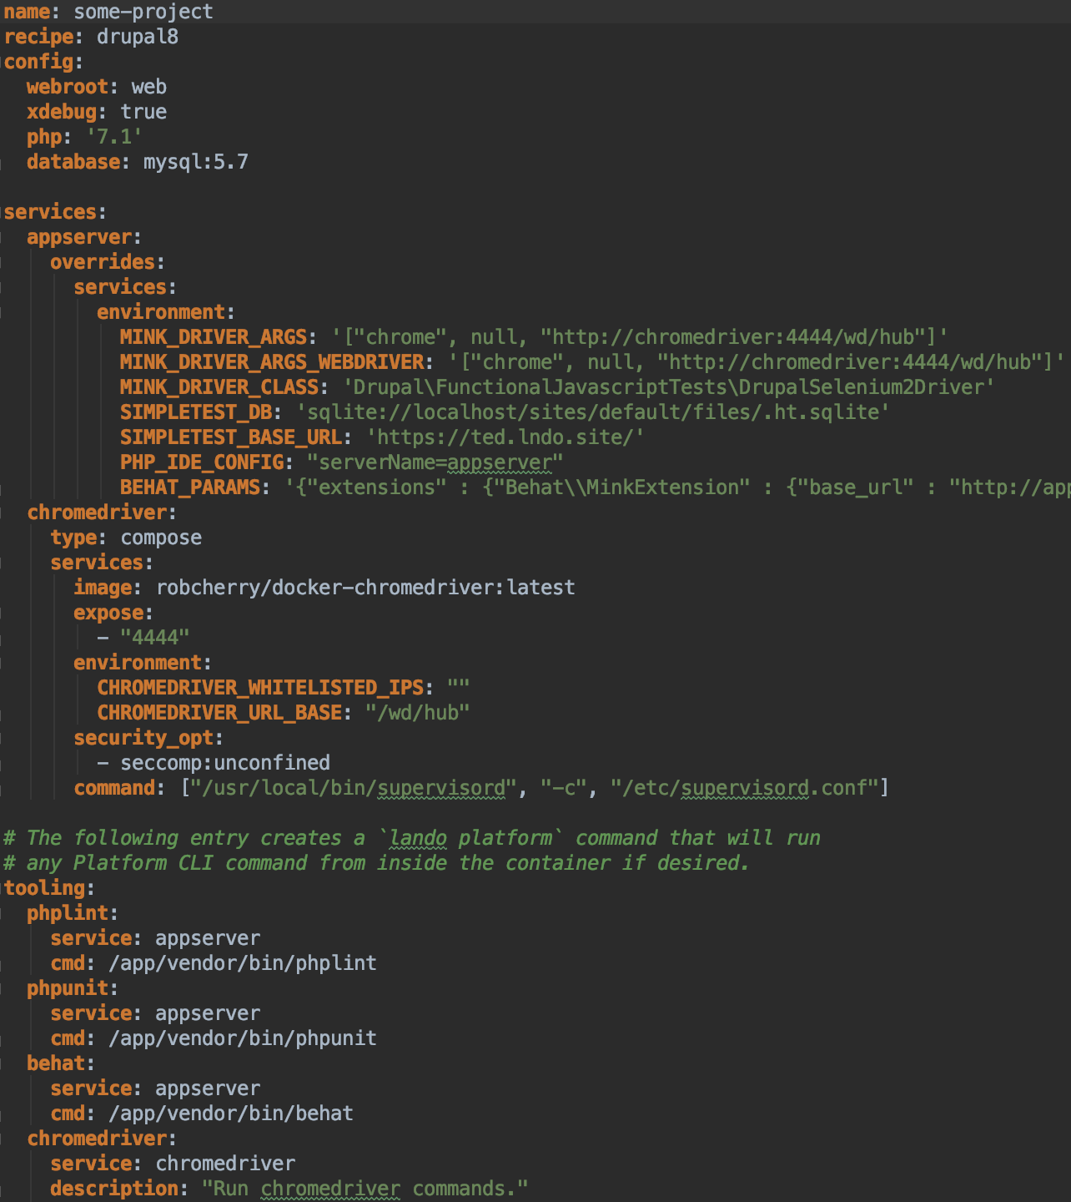
Project and environment setup
composer create-project drupal-composer/drupal-project:8.x-dev some-project --stability dev --no-interaction
lando init
Customize .lando.yml.
PHP and MySQL versions.
Xdebug.
Tooling.
Headless Chrome for functional testing.
Every developer runs the same image.
No dependencies added to repo.

Slide 36
Application deployment
Pull deploys.
> git fetch origin
> git checkout [tag]
> composer install
> vendor/bin/drush updb –y
> vendor/bin/drush entup –y
> vendor/bin/drush cim –y
> vendor/bin/drush cr

Slide 37
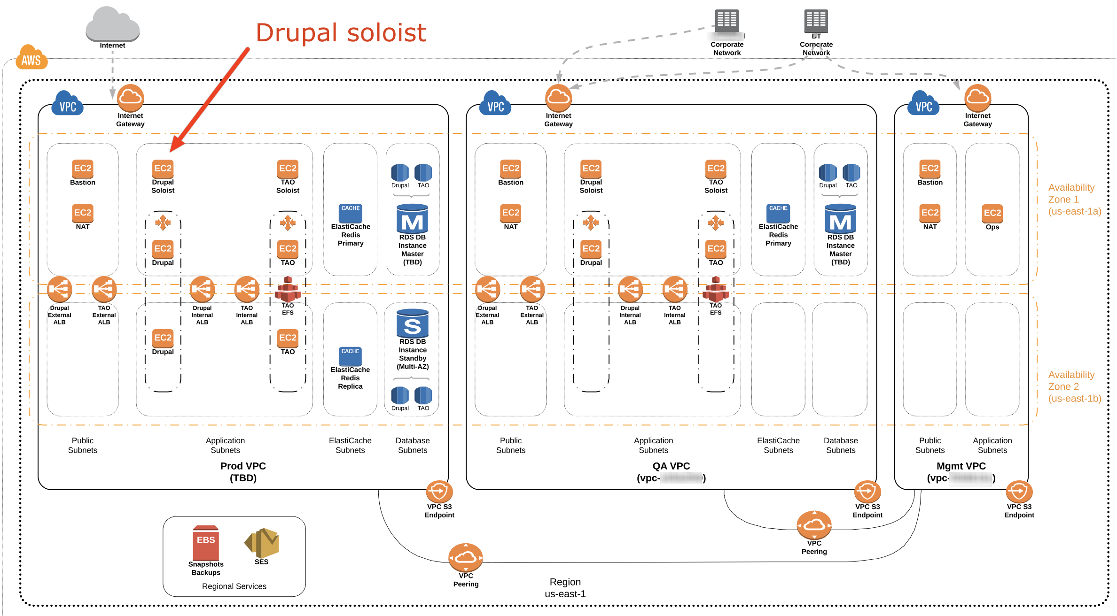
Application deployment

Slide 38
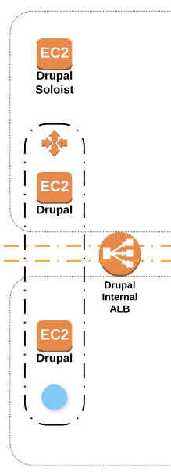
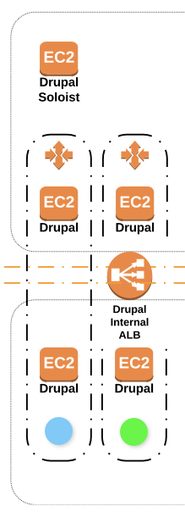
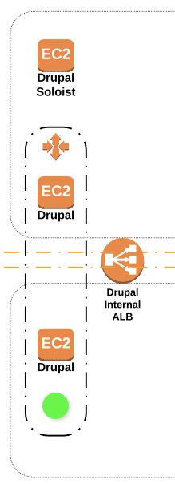
Server deployment
Start up soloist server.
Deploy code to soloist server.
Update Chef cookbooks if needed.
Create AMI of the soloist.
Update Terraform with new AMI ID.
terraform apply – kicks off AutoScaling driven Blue-Green style deployment.
Brings up Green servers with new code and configs.
Add Green servers to internal and external ALBs.
When Green servers are in service, terminate Blue servers.
1
2
3

Slide 39
Why?
This type of deployment reduces site’s downtime to practically nothing.
Most times to actually nothing.
Automation reduces human error.
Can use Jenkins to automate Terraform deploys. (We are exploring this!)

Slide 40
Auto Scaling

Slide 41
Auto scaling
We don’t use performance-driven scaling for all projects, or even all applications within a project.
Auto-scaling in smaller-load projects for self-healing. Misbehaving servers are terminated and automatically replaced.
Soloist style deployments.

Slide 42
Auto scaling needs
Each project has different scaling rules. Professional certification practice exam site with 600 concurrent users doesn’t require a lot of scaling, but state-wide, next-gen standardized testing system with 6,200 concurrent users does.

Slide 43
Auto scaling rules
Baseline step scaling (CPUUtilization is aggregate of all currently running servers)
Add 2 instances when 10 <= CPUUtilization < 20
Add 4 instances when 20 <= CPUUtilization < +infinity
Busy step scaling
Add 4 instances when 50 <= CPUUtilization < 80
Add 8 instances when 80 <= CPUUtilization < +infinity

Slide 44
Diagnostics

Slide 45
Logs and alerts
OS, middleware, and Drupal watchdog logs aggregated to CloudWatch Logs.
Retain logs in perpetuity even after autoscaled EC2s are terminated.
Also log Load Balancer requests.
Allows for creation of metric alarms creation (e.g., "alarm when 'PHP Fatal' shows up in php-fpm error log) - this never happens though :)
Alerts routed to DevOps project team for assessment and mitigation

Slide 46
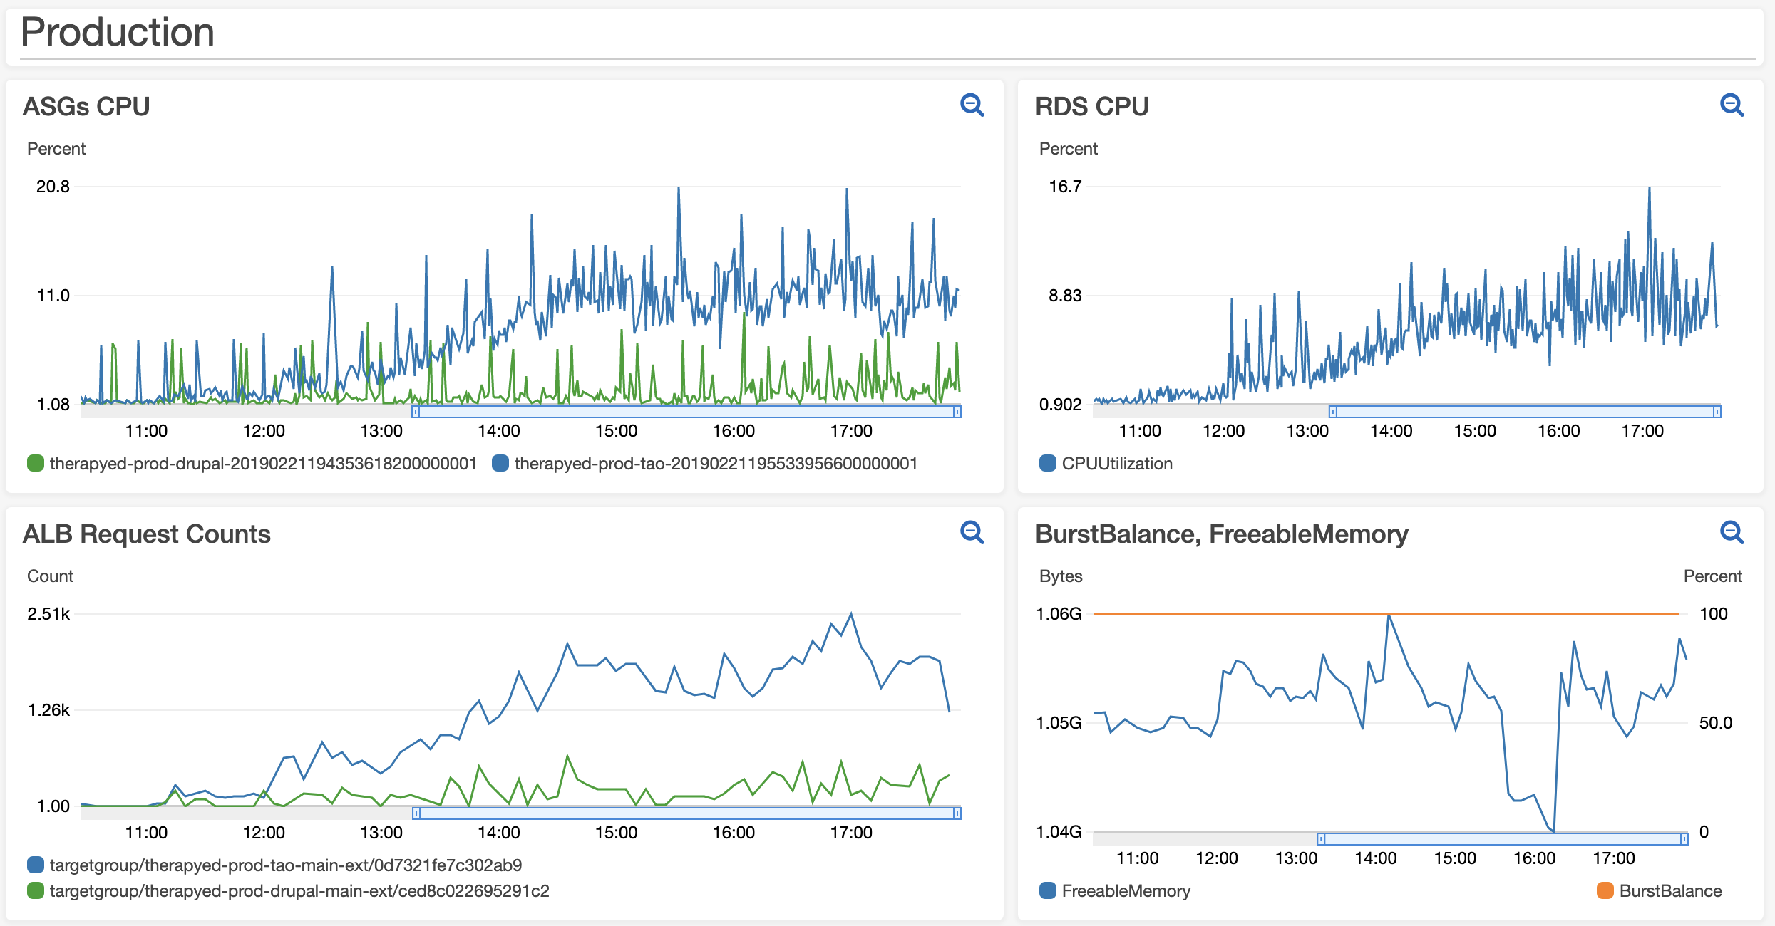
Diagnostics – CloudWatch dashboard

Slide 47
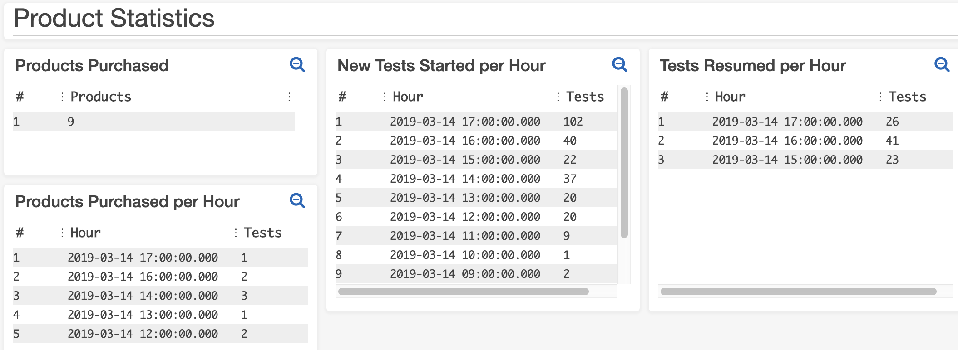
Diagnostics – CloudWatch insights

Slide 48
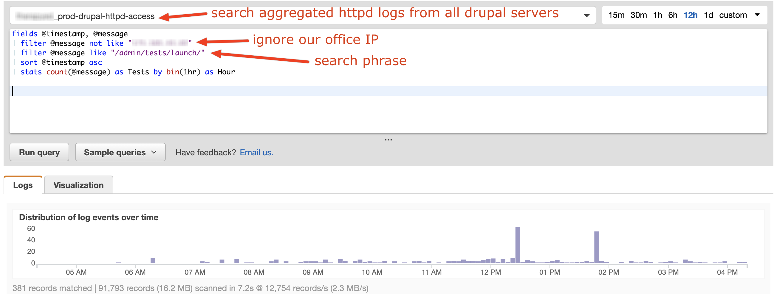
DIAGNOSTICS – CLOUDWATCH INSIGHTS

Slide 49
Q&A

Slide 50
https://www.breaktech.com
Session feedback
http://mid.camp/266
Jonathan “Jack” Franks
Jonathan.franks@breaktech.com
Michael Wagner
michael.wagner@breaktech.com

